Slide 1



Using instagram posts to compare disney parks— An application of sentiment analysis
Author: Sridevi Suresh

Slide 2


Slide 3

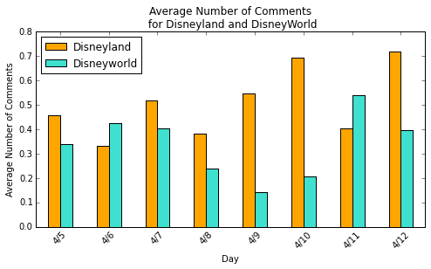
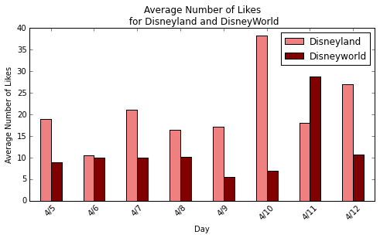
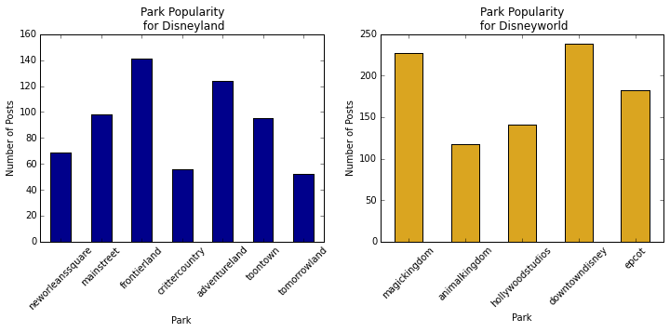
intro
The goal of this project is to quantify which park is better: Disneyworld or Disneyland. Our hypothesis is that Disneyworld is better than Disneyland.

Slide 4
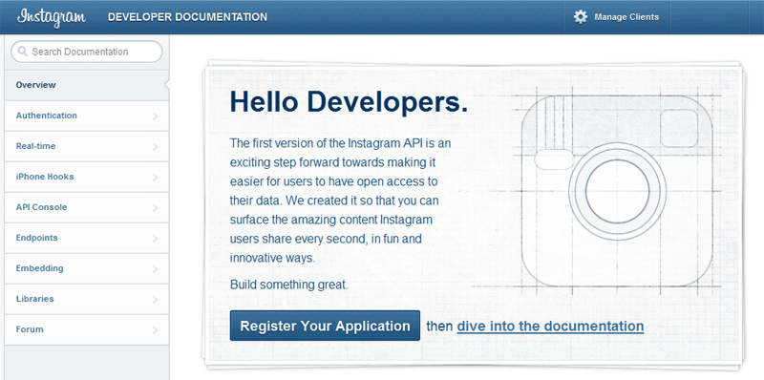
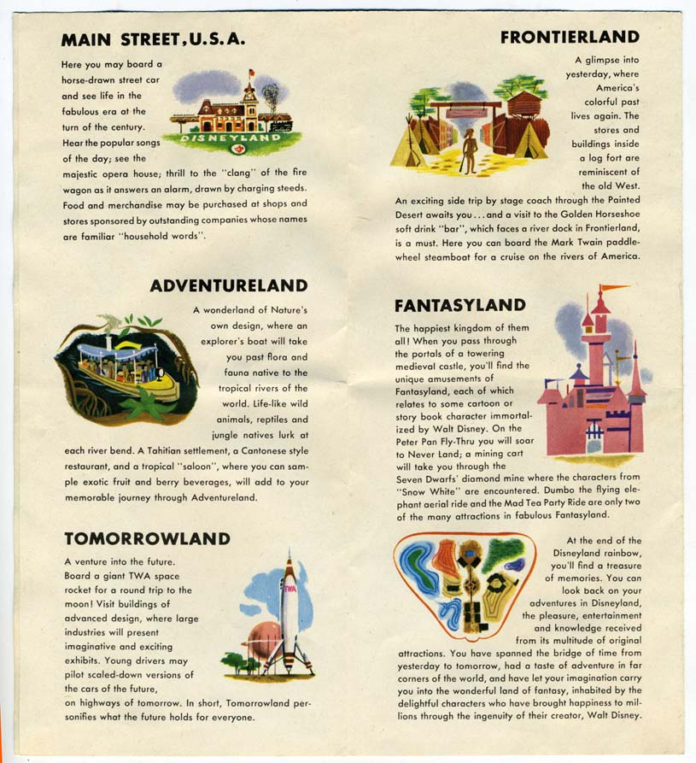
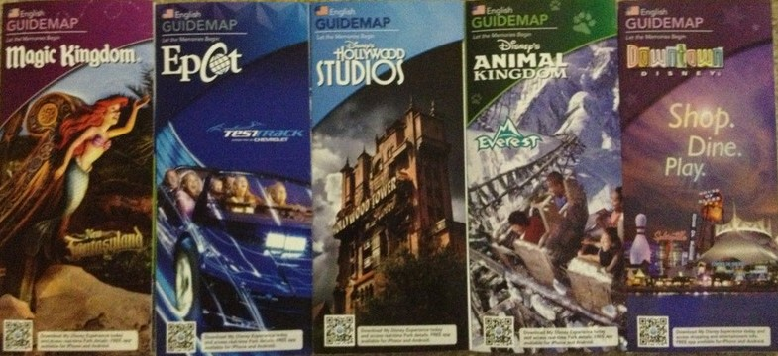
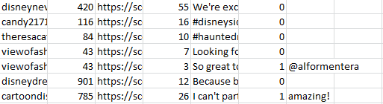
Data Collection
We requested access to the Instagram API. We retrieved information based off of the hashtag used on Instagram.

Slide 5
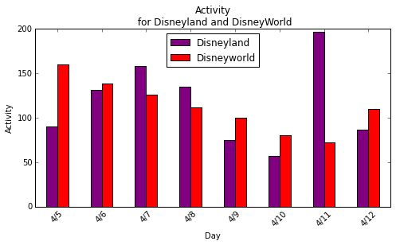
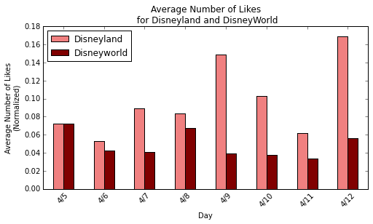
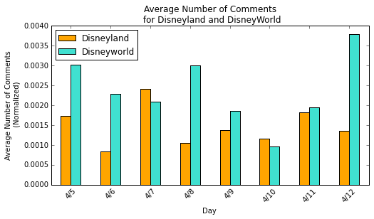
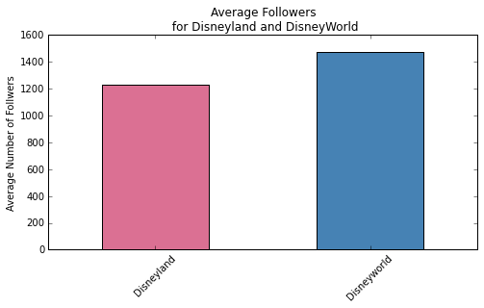
Initial Analysis

Slide 6
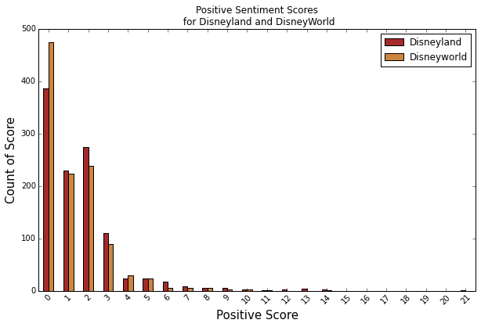
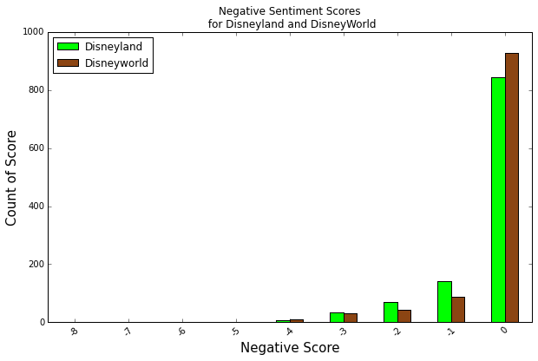
Sentiment Analysis
Conclusion: Disneyland is better…is it really?

Slide 7
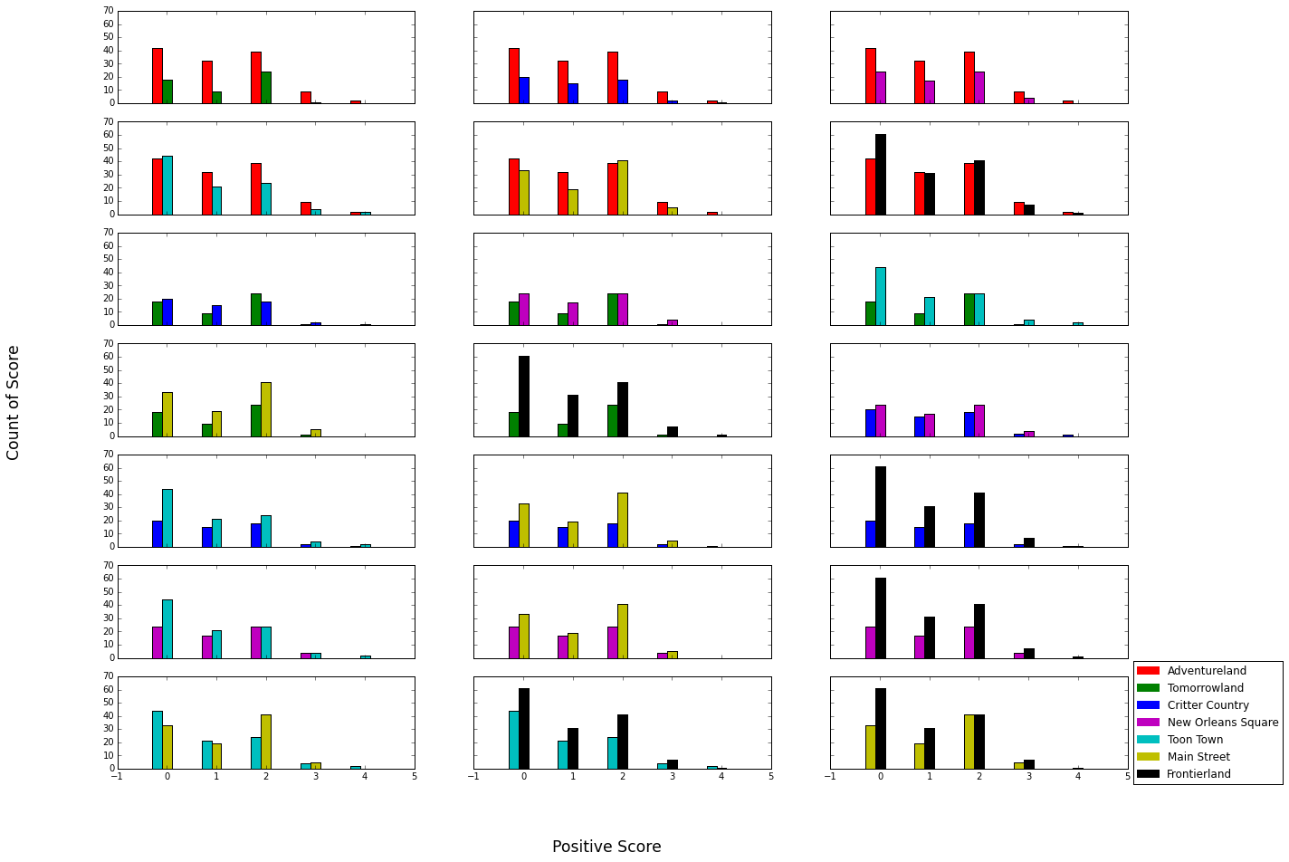
Disneyland Park Analysis: Positive Sentiment Scores

Slide 8
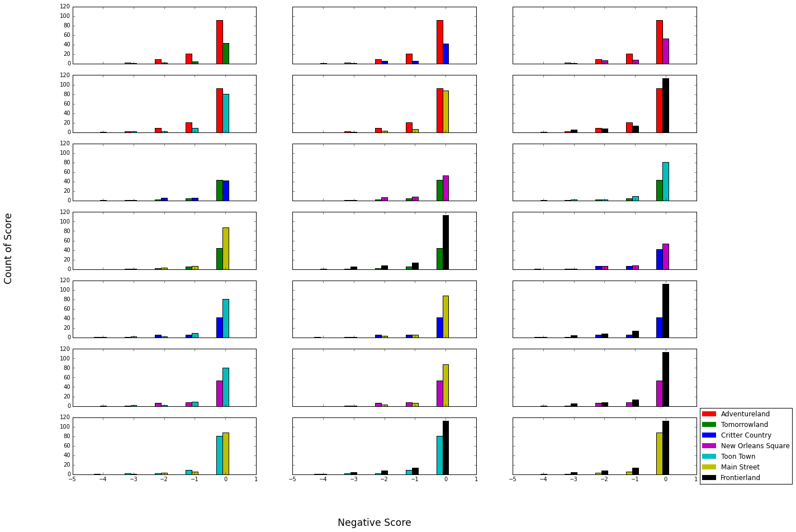
Disneyland Park Analysis: Negative Sentiment Scores

Slide 9
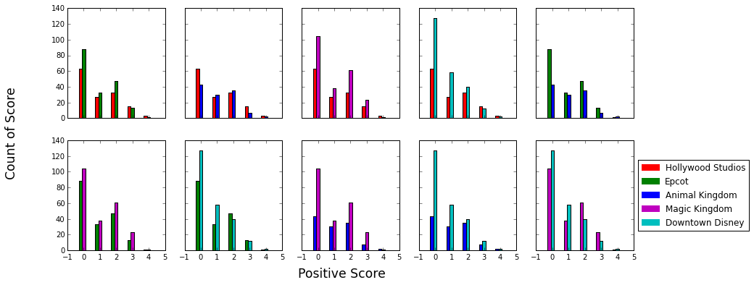
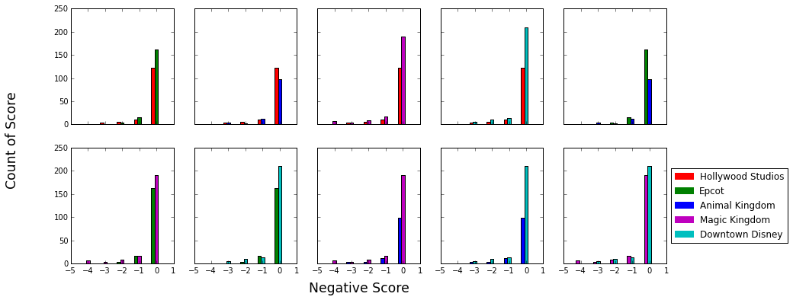
Disneyworld Park Analysis: Sentiment Scores

Slide 10
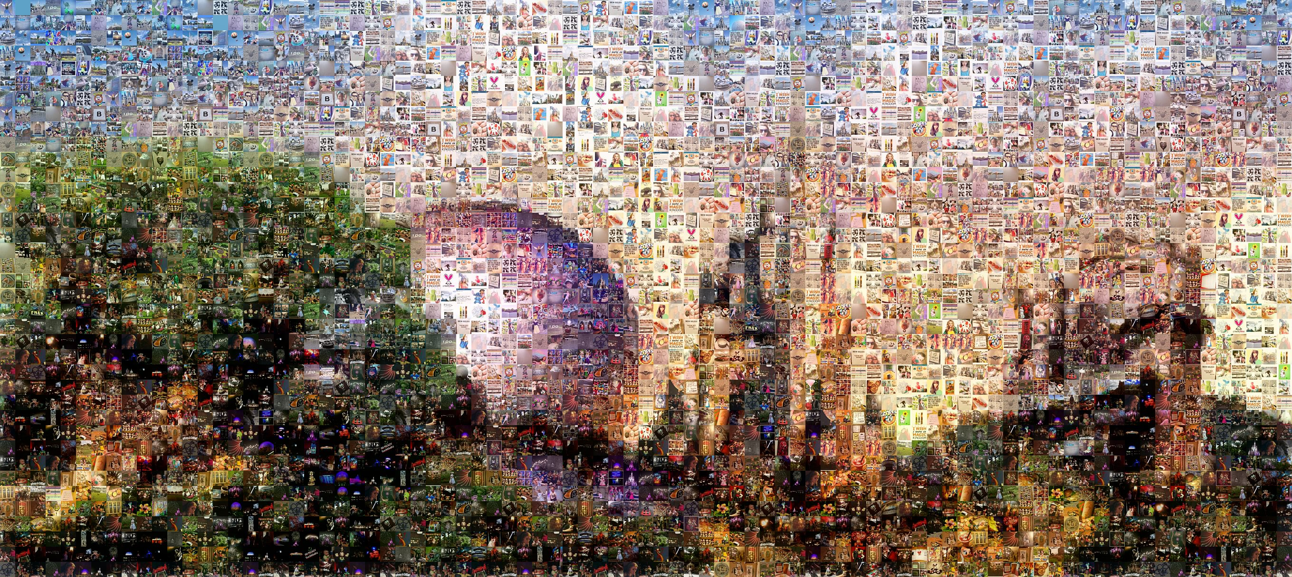

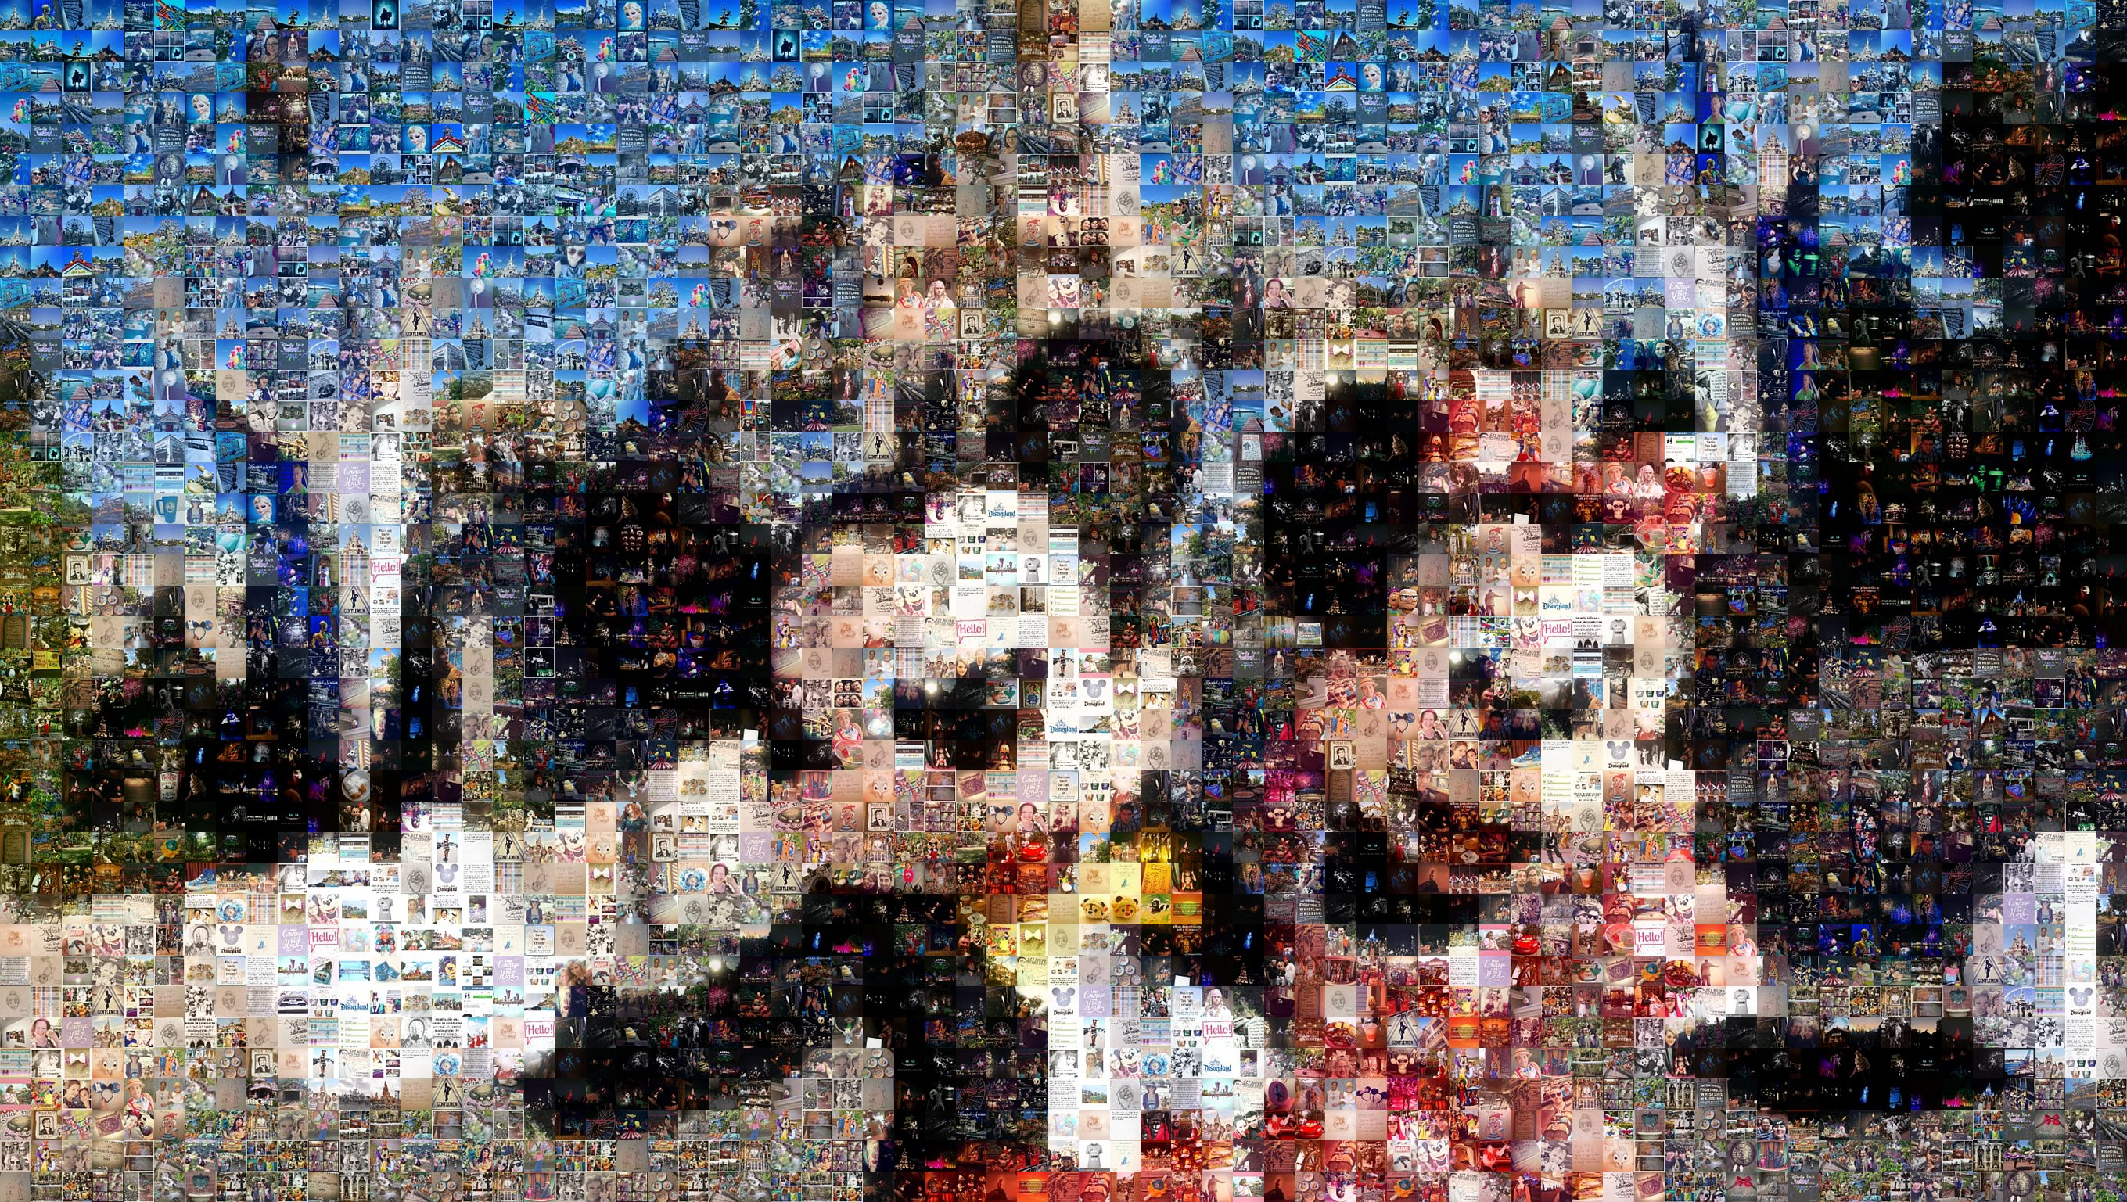
Citations:
Instagram API
Senti-strength
Python-instagram
Mazaika
BU,
Computer
science
Disney

